Slide 1

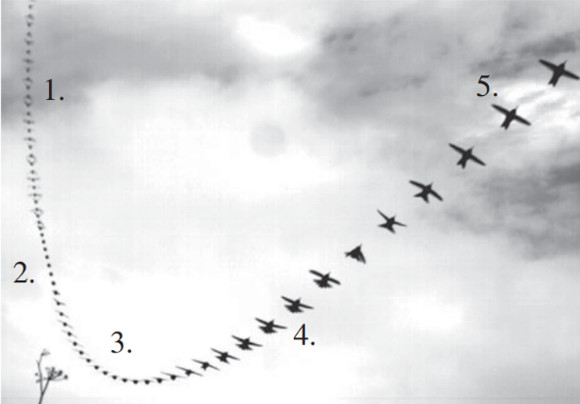
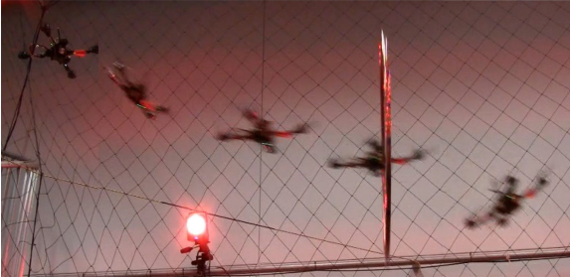
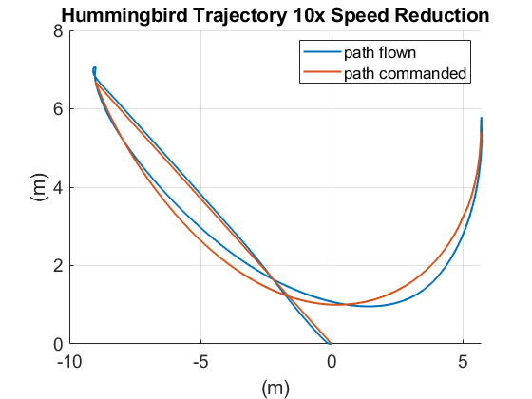
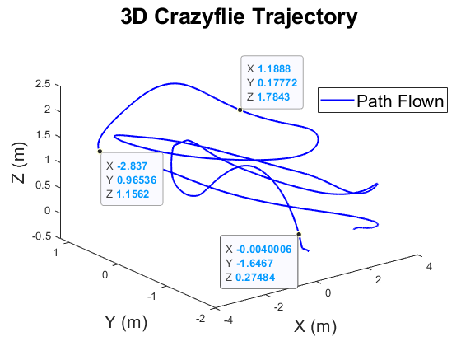
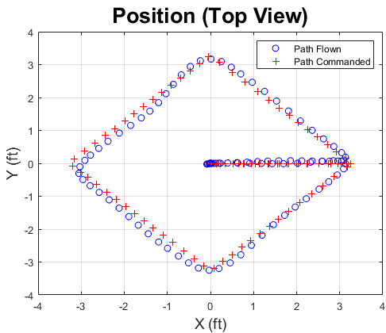
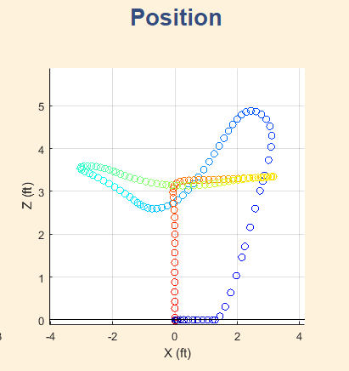
Autonomous Trajectory Planning to Copy Bird-like Maneuvers
MIDN 1/C Ethan Marcello and Prof. Dennis Evangelista
Motivation
Methods
Results
Trial | X | Y
1 | 2 | 5
2 | 3 | 6
3 | X | y
Animals moving in complex environments are an excellent source of inspiration for improving robots. This project is inspired by the extreme maneuverability of the male Anna’s Hummingbird (Calypte anna). I hope to make use of their phenomenal dive maneuvers to enhance the ability of quadrotor drones.
Simulation (MATLAB Simulink):
Rigid Body Model:
Body Properties: Crazyflie modeled from bitcraze website and measurements taken by calipers.
Hover condition assumed for control, with pitch and roll angles linearized about an operating point of zero degrees. Attitude angle command saturation limits at +/-12 degrees.
Controller: Position Controller with PID control.
Most results will be reported in a series of graphs, photos, or tables. Each should have a brief caption and explanation.
Be sure the fonts are legible. .png is a good format for graphics that include text. Consider adding text from within PowerPoint for more control, such as annotations and axis labels. Include units.
NRMSE calculations here?
Source: Velodyne Inc.
Figure 1: (a) The five stages of an Anna’s Hummingbird dive maneuver, from [Clark 2009]. (b) A quadrotor using path planning to fly through a thrown hoop, from [Kumar YYYY]
Problem Statement
Figure N: Simulated Crazyflie flying the true Hummingbird trajectory at one tenth the actual speed.
Succinct, precise. Consider using a common format such as “given-find”, hypothesis, or “research questions”. Be sure to clearly define the process you intend to study, the properties you will demonstrate and explicitly state any assumptions. Include a diagram.
NEXT STEPS:
Hardware Testing (move to autonomous waypoint control with Crazyflie)
Develop controller around different linearization region.
Figure M: (a, b) Simulated quadrotor flying a commanded “Diamond” trajectory in the X-Y plane, while attempting to maintain a 1m hover.
Re: Section Headings
Proof-of-Concept Demonstration:
ROS on linux machine sends commands to Crazyflie and obtains sensor data from Crazyflie, and x,y,z position data from the OptiTrack
OptiTrack Motion Tracking System accurate to +/- 0.5mm
Develop with your advisor. Depending on the nature of your work other headings may be more pertinent. Common options could include: Abstract, Testbed, Controller, Model, Sensors, Sources of Noise, etc.
References
[1] W.-K. Chen, Linear Networks and Systems. Belmont, CA: Wadsworth, 1993, pp. 123–135. (book example, omit page numbers if needed)
See https://libguides.usna.edu/citing/ieee for format style
Related Work
The results section will take up a large portion of the poster.
Feel free to move the sections around if they don’t require a full column.
Acknowledgement
Short mention of other work by number [1], [2].
<<<Pic here of drone flying w/ OptiTrack in background>>>
Professor Chris Clark (trajectories), Professor Cheng, Professor Dawkins, Professor Piper, 2ndLt Canlas, MIDN Guinan
Annotate photo like this.
Notes:
Do not change: page size, background color, font size or font type
You may change: the name of the section headings as appropriate (e.g. Method might be Algorithm, Design Approach or Analysis); You may also remove a section if it doesn’t apply (e.g. Acknowledgements)
Tips:
Graphics should be hi res (will be printed large), captioned, and source listed in caption or on graphic if not self generated. Use white outline. Png is a good file format for matlab plots. Jpg preferred for photos
Plots: make sure fonts for axis labels are readable. Consider adding axis labels or annotations in power point rather than generating software.

